Slide 1
Prairie Kindergarten Preview
March 17, 2025
Never Stop Learning
Notes:
Good morning and welcome, future Prairie School families! It's with great joy that we gather today to embark on an exciting journey together—your child's kindergarten adventure at Prairie. I'm Brian Zallis, the principal here and this is Jen Brandes, our assistant principal. On behalf of our dedicated staff and the entire Prairie community, I extend a warm welcome to each of you.
Today, we'll explore what makes Prairie School a special place for our youngest learners, Whether you're joining us for the first time or have older siblings who've been part of our community, we're thrilled to have you here.
Throughout this preview, we hope to provide you with a brief glimpse into daily life, share insights into our approach to learning, and answer any questions you may have as you prepare for this new chapter. So, let's dive in and discover together what makes Prairie School a place where every child can thrive."

Slide 2
Outcomes
To share information about our kindergarten program and Prairie
To provide parents and guardians an opportunity to ask questions related to our kindergarten program and school
Notes:
Brian
Introduce self and Mrs. Brandes

Slide 3
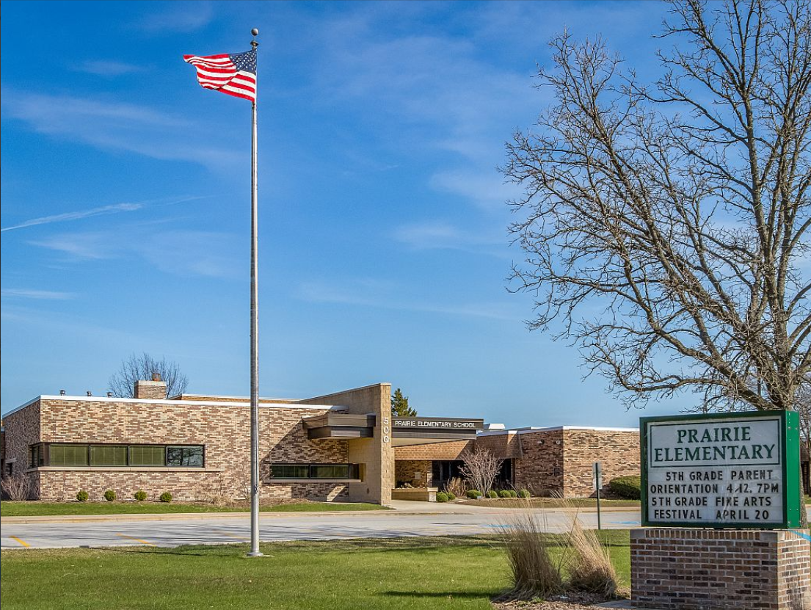
What does our kindergarten program offer?
Excellent teachers who are dedicated to meeting the needs of young learners Our teachers have the skills and experience to support each child’s growth, making sure they are challenged and encouraged at every step. High-quality lessons and resources to engage students We use carefully selected curriculum and materials that are exciting and engaging, helping children develop important skills and a love for learning. Plenty of opportunities for learning and personal growth Your child will have many chances to explore, ask questions, and discover new ideas, all while building confidence and growing their abilities. A classroom environment that is designed for young children’s development The space and activities are set up to support your child’s social, emotional, and academic growth, ensuring they feel safe, valued, and ready to learn.
Notes:
Brian

Slide 4
How do I enroll my child?
www.naperville203.org/kindergarten
Click on Enrollment Intake form
Complete and submit the form
You will receive an email with next steps (within 48 hours)
Notes:
Brian

Slide 5
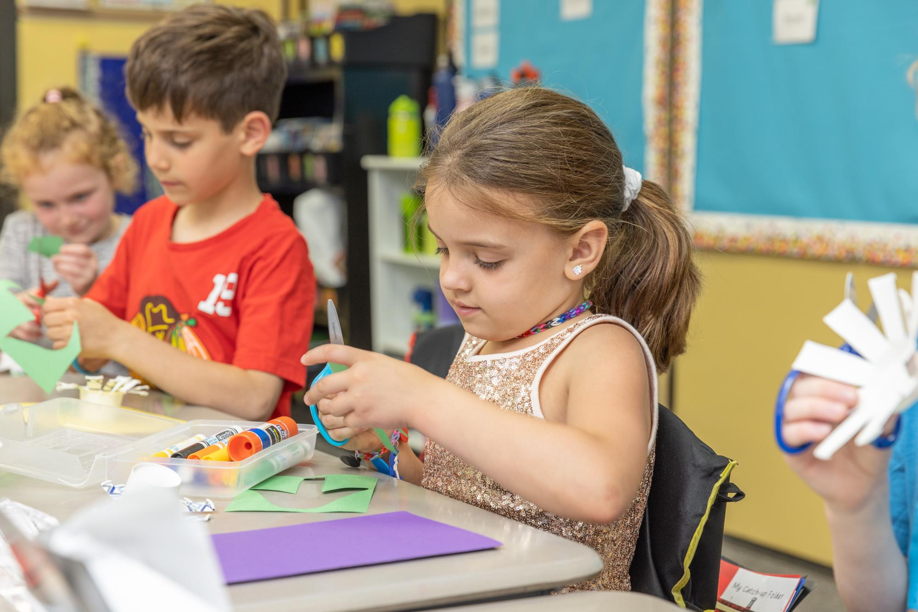
What is required before I enroll?
Children must be 5 years old on or before September 1, 2025
All Students- an online application must be completed for all students
Notes:
Brian
Following the completion of the online application, an appointment should be scheduled with our centralized enrollment office to submit proof of residency documentation and your child’s birth certificate in person.

Slide 6
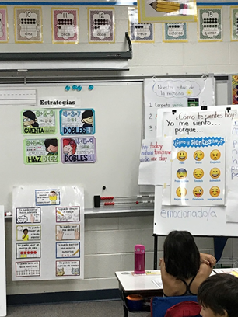
What would my child experience in Spanish Dual Language?
The philosophy of the Naperville School District Dual Language Program is to educate our students to become bilingual, bi-literate, and multicultural in this ever increasing global society.
In addition to the components of the all day model, Dual Language students will experience:
•Literacy and content (Math, Science, Social Studies) learning in two languages throughout the whole day using the same curriculum as the general education classes. (In Kindergarten, 80% of instruction is conducted in Spanish with built-in language support for students who are learning Spanish as an additional language.)
•Opportunities to learn about the cultures of the Spanish and English-speaking worlds.
Notes:
Jen

Slide 7
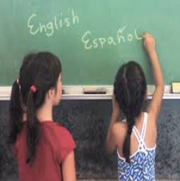
How can I enroll my child in Dual Language?
Available River Woods
Enroll your child in Kindergarten by Friday, March 21, 2025 to be entered in the lottery
Mark that you want your child to be considered for the Dual Language program on the enrollment form
Lottery results will be emailed on April 11, 2025
Younger siblings of current Dual Language students are given priority enrollment (they must be fully enrolled by March 21, 2025 as well)
Classroom Makeup: Approximately 50% students who speak English or other languages at home and 50% students who speak Spanish at home
Want to learn more?
Visit the district website www.naperville203.org (Departments & Services→ Dual-Language →Kindergarten Information)
Notes:
Jen
Beebe, Elmwood, Mill, Steeple Run – Edit red font to show as your own program
Ellsworth, Highlands, Kingsley, Maplebrook, Meadow Glens, Naper, Prairie, Ranch View, Scott, River Woods – Edit red font to show as Magnet Dual Language. All must apply for lottery to be selected no matter the home school.

Slide 8
Dual Language Sites
Sites for students from attendance area only:
Beebe Mill Street Elmwood Steeple Run
Magnet site for all others who wish to participate in the Dual Language Program:
River Woods
Lottery application deadline is
Friday, March 21, 2025
Want to learn more?
Visit the district website www.naperville203.org (Departments & Services→ Dual-Language →Kindergarten Information)
Notes:
Application for dual-language is part of the online enrollment

Slide 9
May I choose half day?
Yes-Families may choose half day.
Program specifics:
•Attend at your home school as part of the full day class
•Begin school at 8:15; dismiss at approximately 10:45
•Participate in instruction scheduled during those hours
Notes:
Not necessary to share whole group but important for individual conversations you may have with Kindergarten parents: Dismissal for half-day Kindergarten can be flexible to determine an appropriate transition time. For example, if Kindergarten has lunch at 11:15 then that could be the dismissal time if agreed upon between parent and principal.

Slide 10
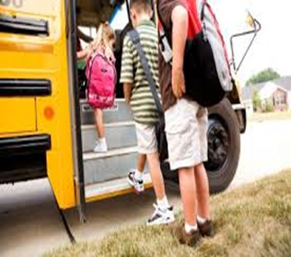
Eligibility for Bus Transportation
The District provides bussing for all families who live 1.5 miles or more from their home school.
In some special circumstances, families who cross streets designated as hazardous are also provided bussing.
Notes:
Jen

Slide 11
8:00 -- Doors open for students
8:15 -- All students in seats and ready for the day
2:30 -- Dismissal
Notes:
Jen

Slide 12
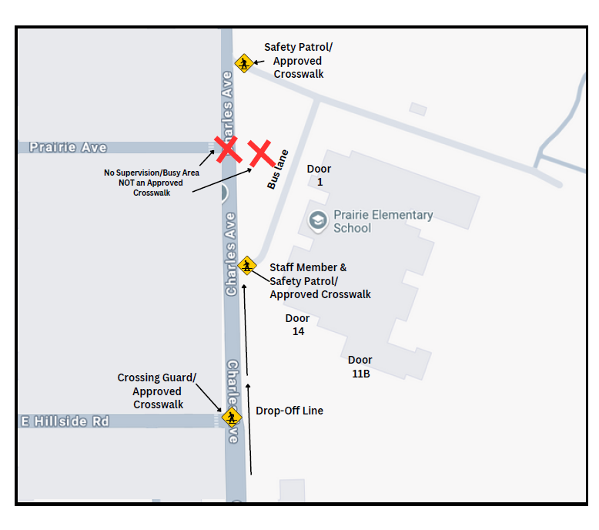
Morning Arrival
Key Points:
The Drop-Off Line is fluid; parents should not leave their vehicle; Drop and Go
The Crossing Guard is located on Charles and Hillside.
We use three doors for student admittance into the building:
Door 1 (Atwater’s, Smith’s and MacDonald’s Kindergarten Classes and all bus riders)
Door 14 (3rd, 4th and 5th Graders)
Door 11B ((Mrs. LaPerna’s Kindergarten Class as well as 1st and 2nd Grades)
All visitors enter through Door 1 and follow screening protocols
Notes:
Brian--Jen will go get the teachers

Slide 13
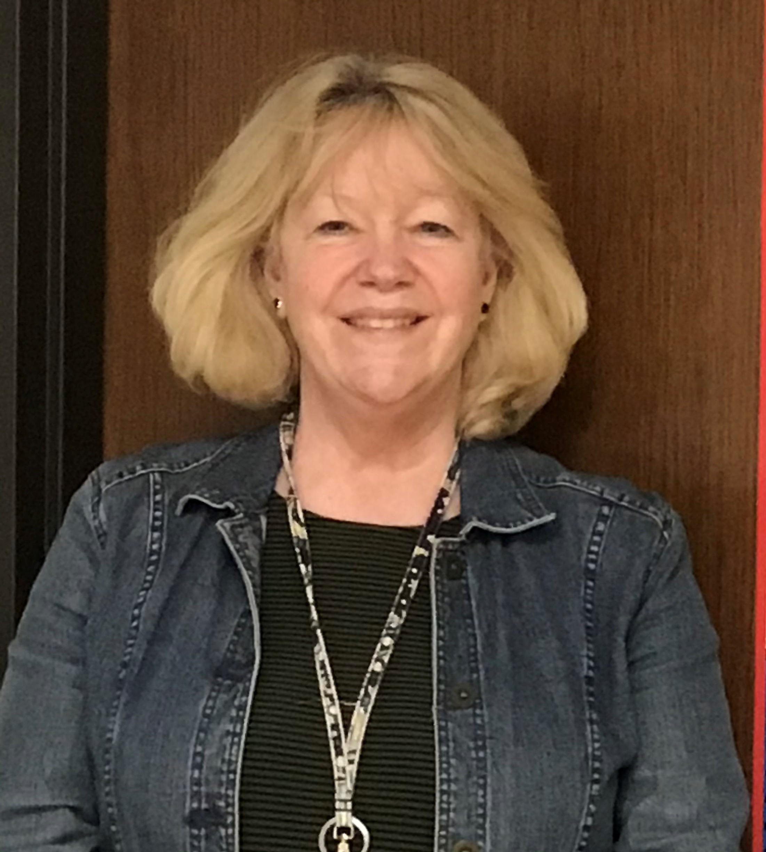
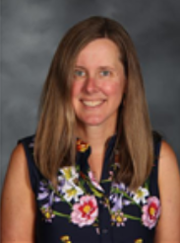
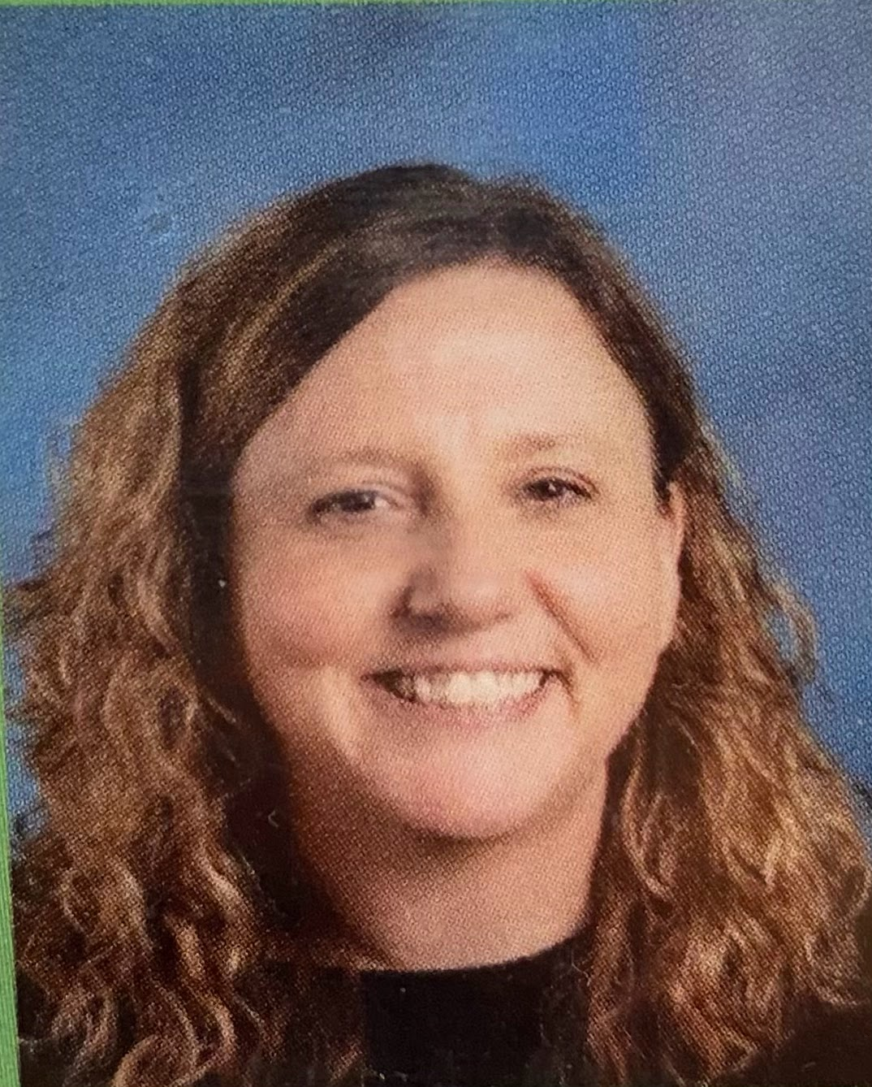
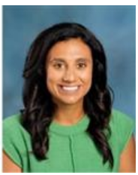
Meet Our Kindergarten Team
Ms. Atwater
Mrs. LaPerna
Mrs. Smith
Mrs. MacDonald

Slide 14
A Look At Prairie’s Kindergarten Day
*Morning Meeting and Social Emotional Learning
*Literacy - Heggerty, Phonics, Reading, Writing
*Science
*Social Studies
*Math

Slide 15
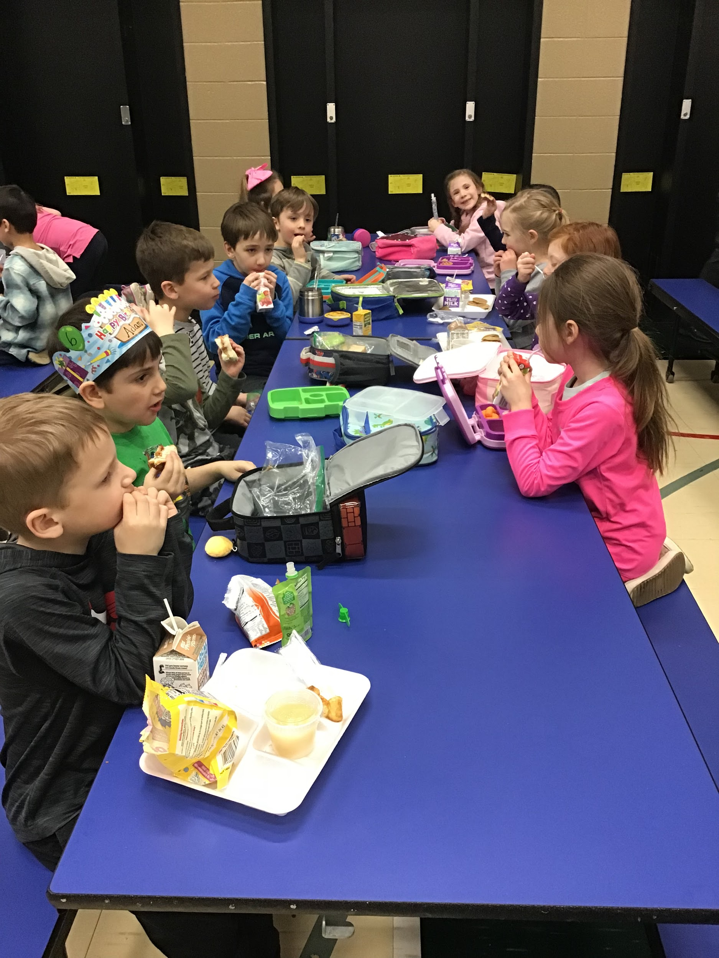
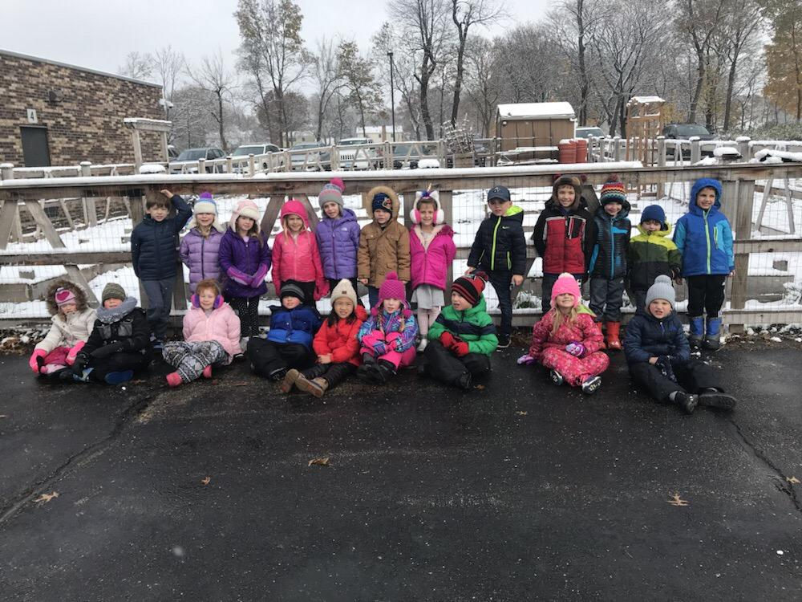
A Look At Prairie’s Kindergarten Day
Kindergarteners…
Eat lunch with classmates in a supportive environment
May bring or purchase their lunch
Recess (20 minutes) included in the lunch schedule
Morning Recess - Kindergarten is outside for 20 minutes each morning

Slide 16
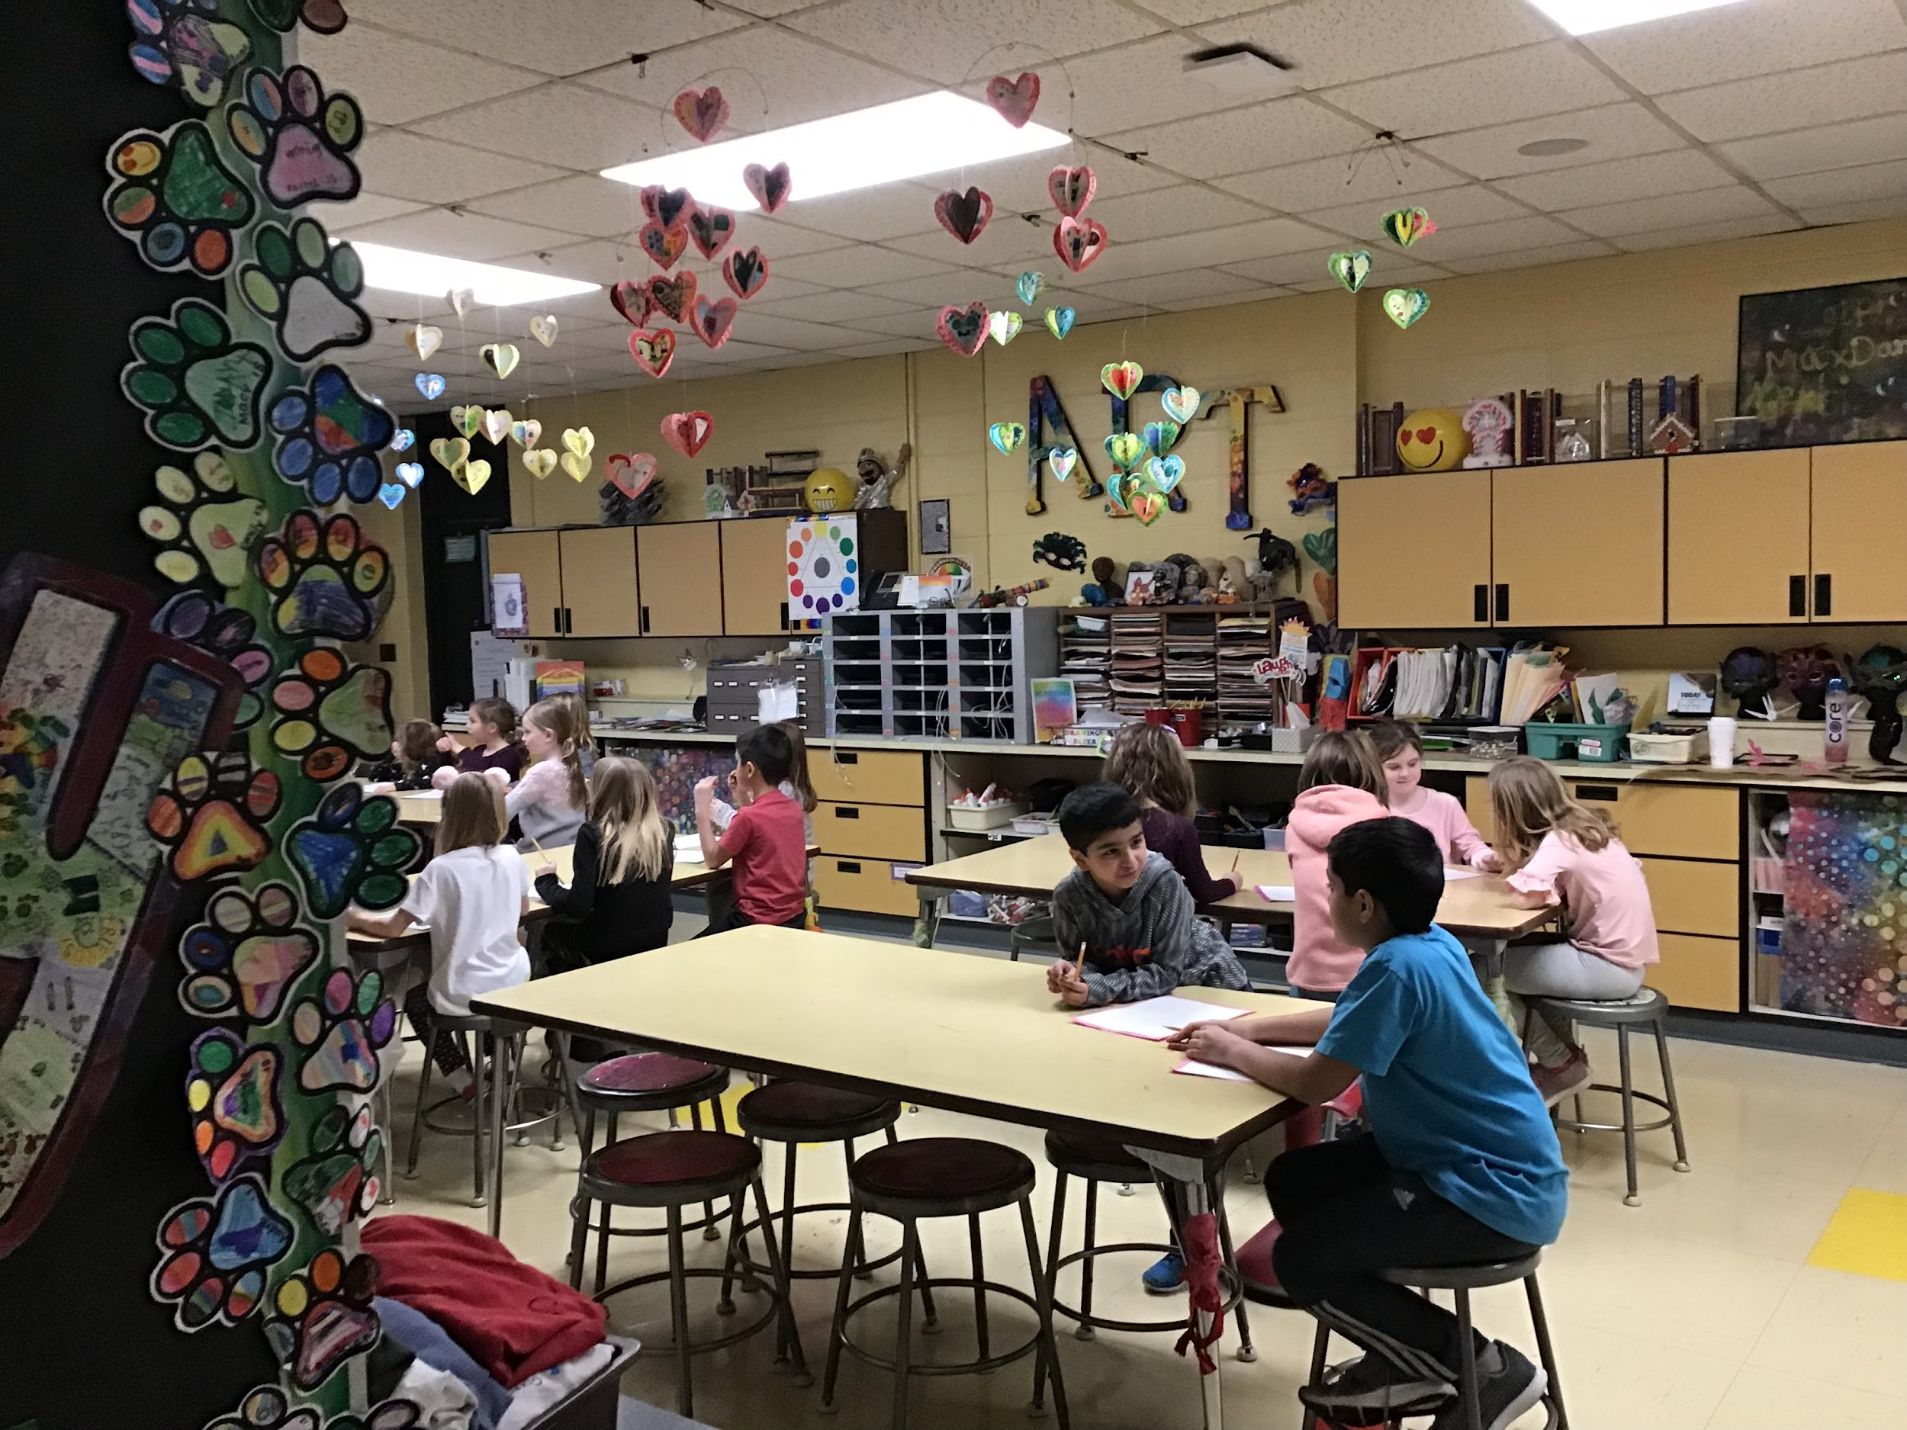
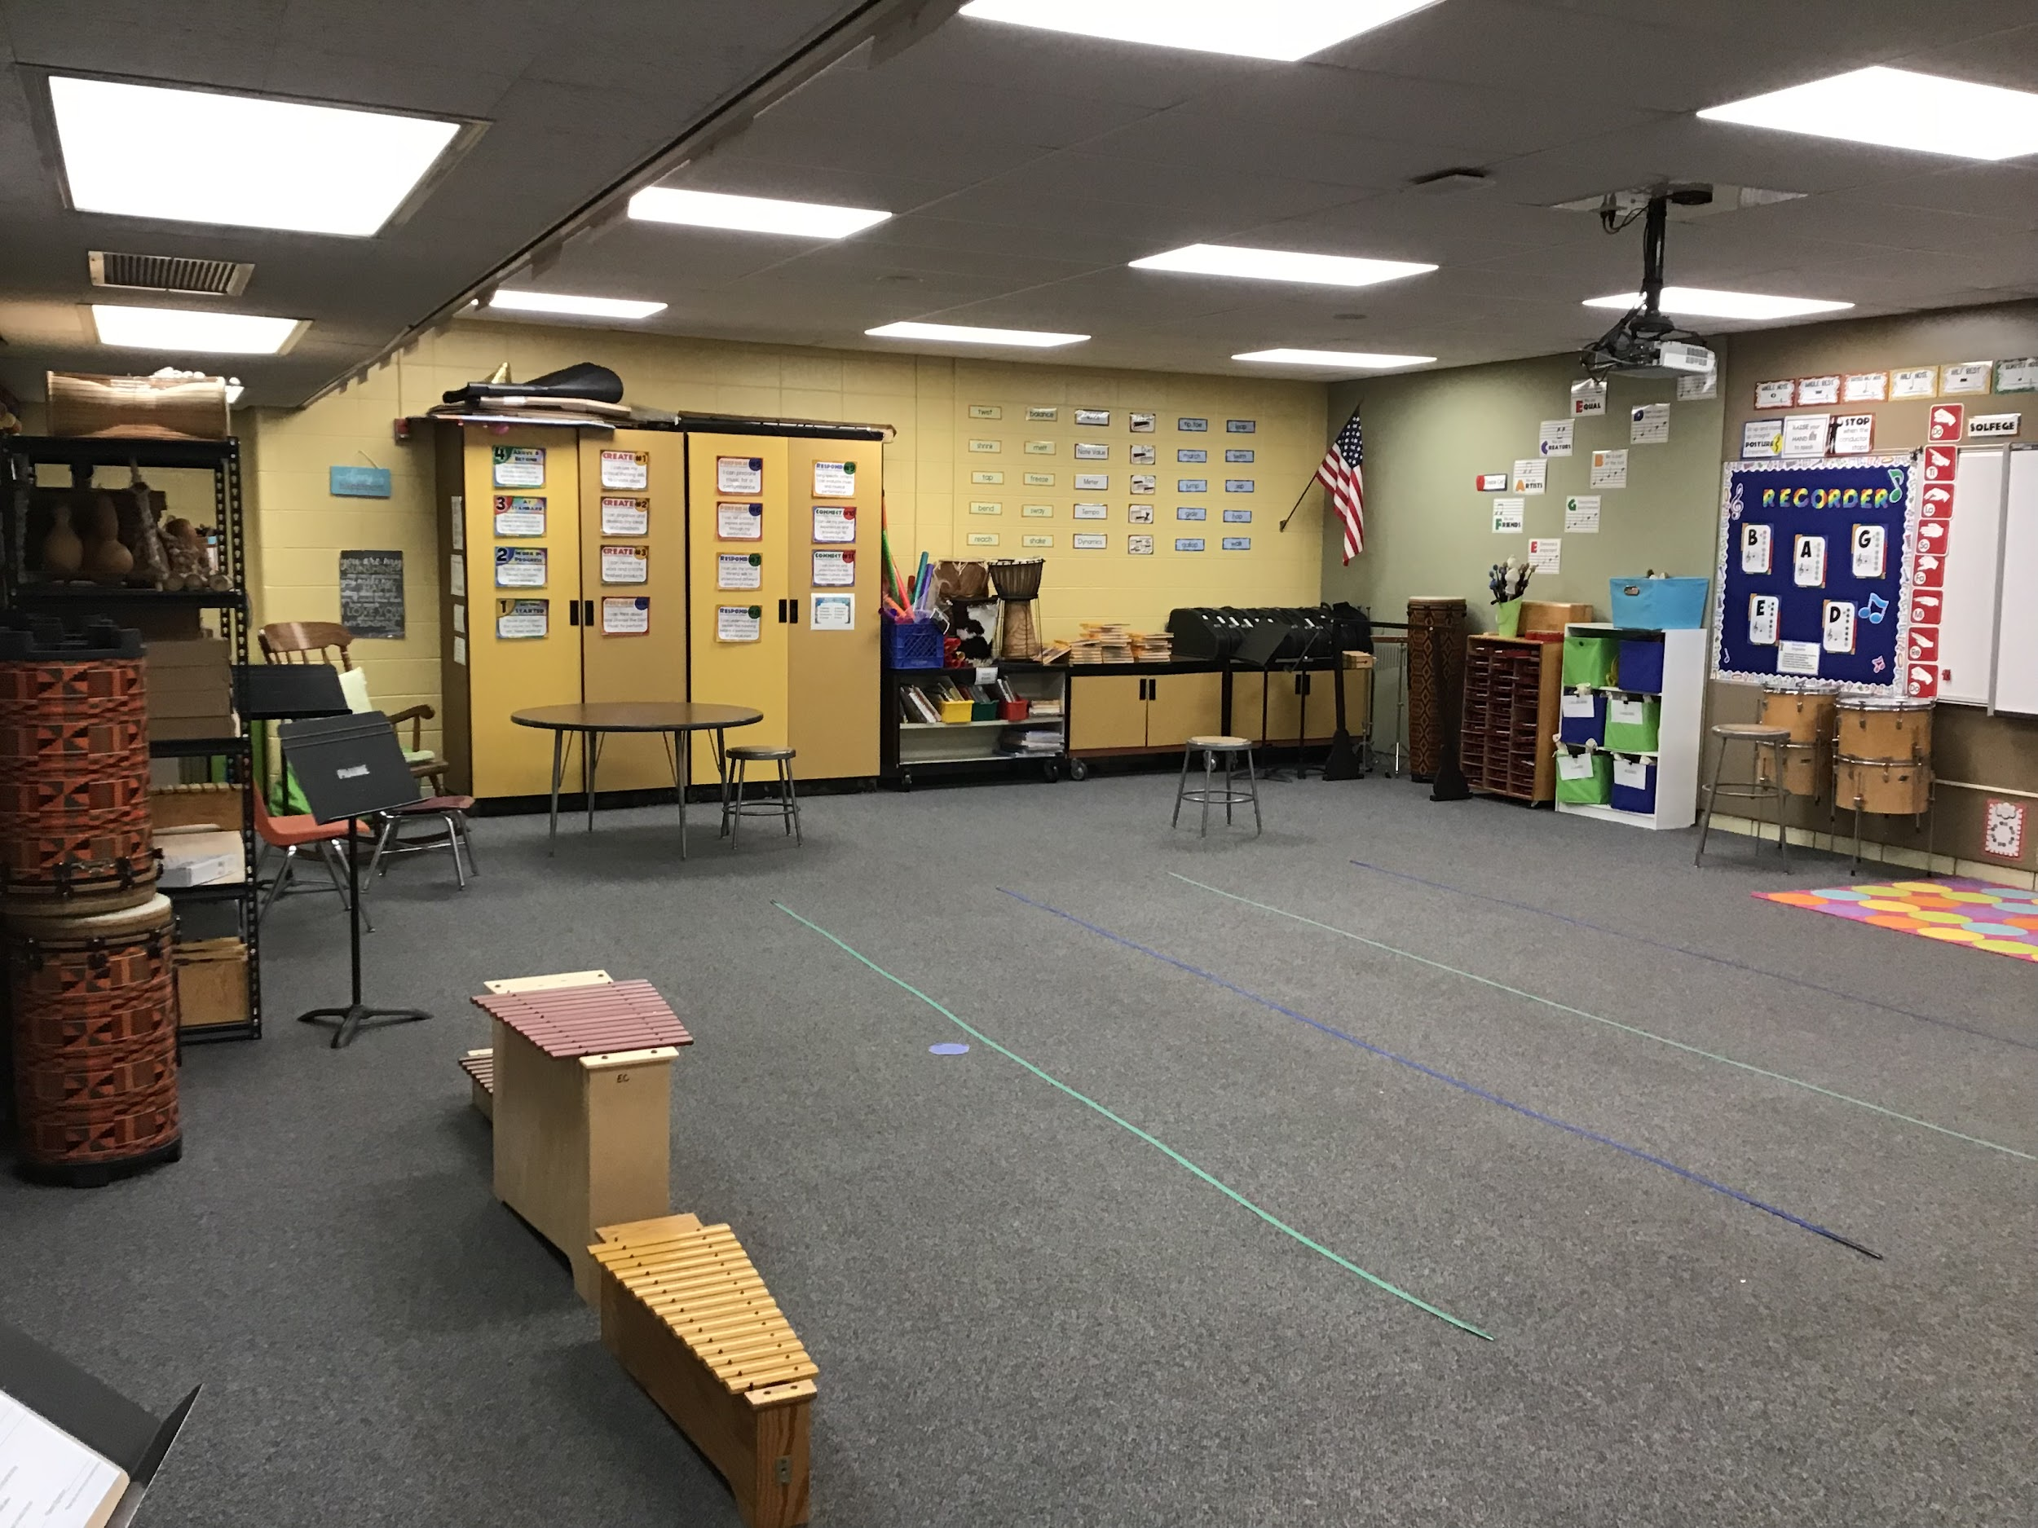
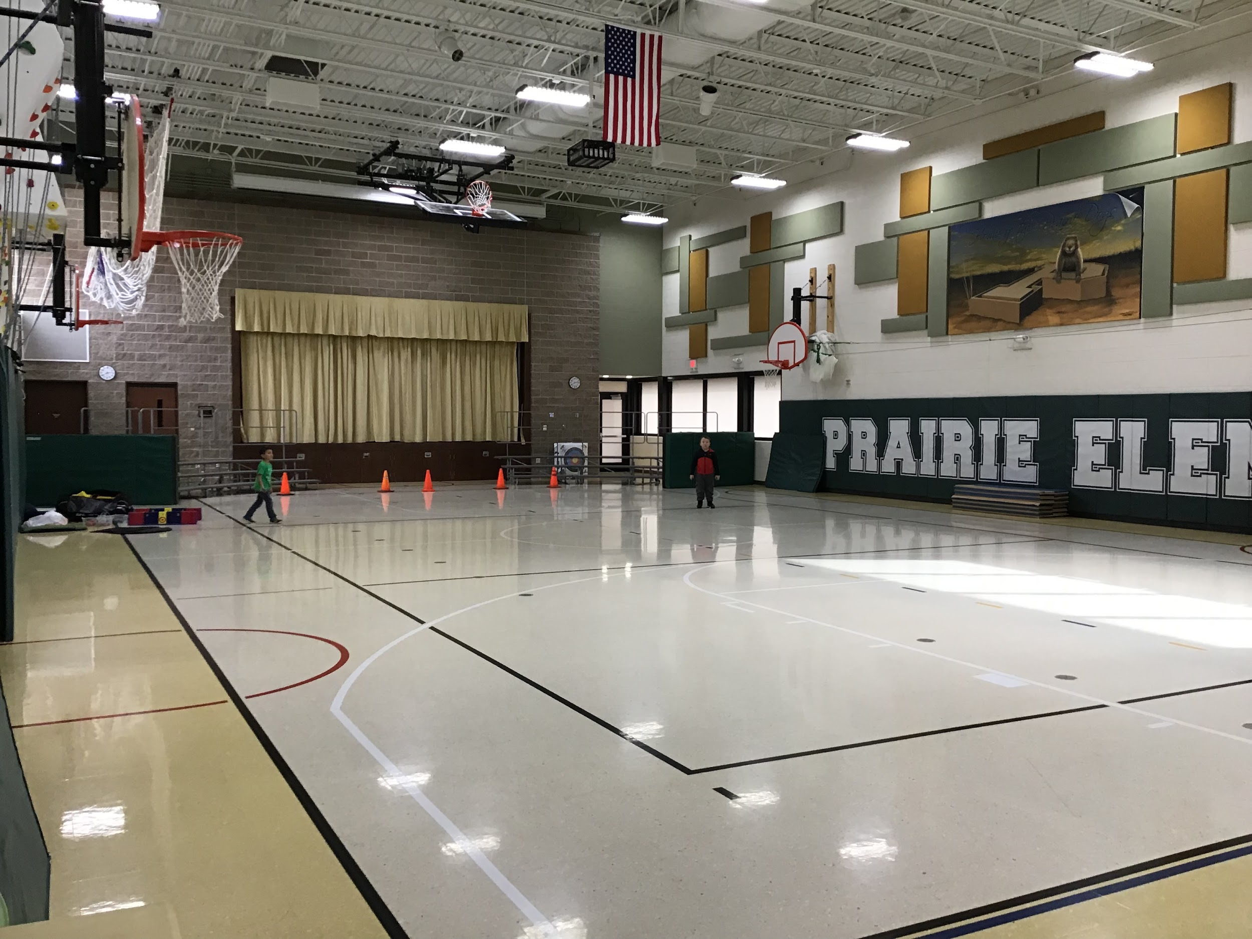
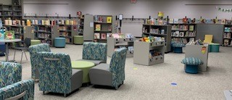
What do Kindergarten Specials look like?
Art…once per week (50 minutes)
Music…twice per week
(25 minutes)
PE…twice per week (25 minutes)
LC...once a week
(50 minutes)

Slide 17
Prairie Pride
Positive: I will choose to focus on what is good, helpful, and useful.
Respectful and Responsible: I will show everyone and everything that they are good, valued, and important.
Independent means: I feel comfortable doing the best I can on my own.
Driven means: I will try. I may succeed, I may fail, but I will persist.
Empathetic: I will understand and share another person's experiences and emotions.
Notes:
Jen goes to get Jill and Amanda

Slide 18
Welcome from the Health Office Team
Certified School Nurse: Jill Accardo, RN, PEL-CSN
Holds professional educator license endorsed in
school nursing in Illinois.
Promotes the physical, mental, emotional and social well being of students by providing comprehensive school health services.
Health Technician: Amanda Wood
Works under the direction of the School Nurse;
provides first aid treatment, including emergency
care; takes attendance; CPR and first aid certified.

Slide 19
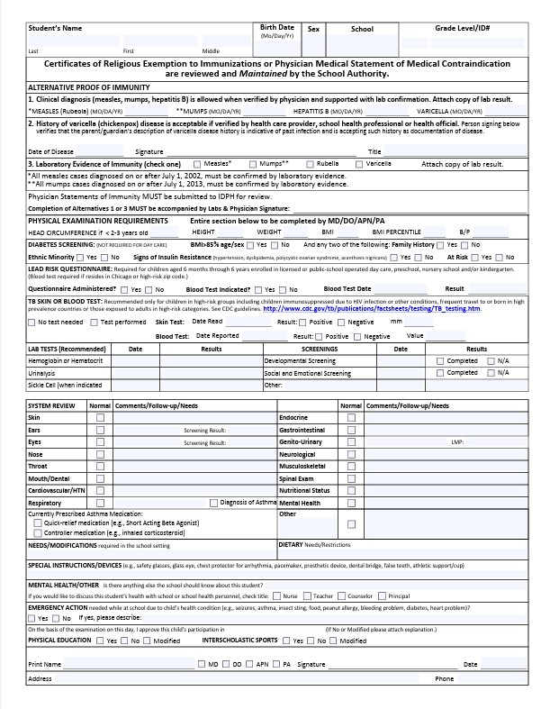
Health Requirements-Physical Exam
All physical exam and immunization requirements should be fulfilled prior to the first day of school.
Exam must be performed within 1 year prior to the first day of school (on or after 8/14/24).
May be completed by licensed physician, nurse practitioner, or physician’s assistant.
New version of form required after January 1, 2025. We are not allowed to accept the old version from 2015.

Slide 20
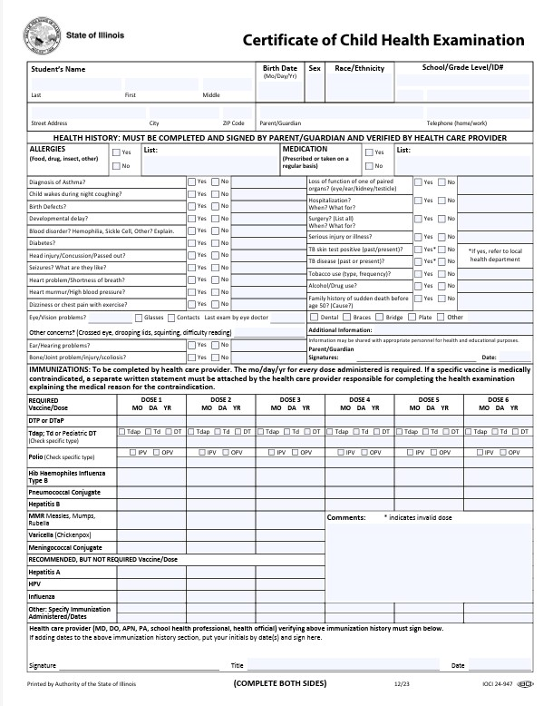
Health Requirements-Immunizations
Health history portion must be completed and signed by parent for physical to be valid.
Immunizations must be up-to-date and verified by a healthcare practitioner using signature and date
Form can say “see attached” if electronic medical record printout is signed and dated by the practitioner

Slide 21
Health Requirements-Vision Exam
The vision requirement should be fulfilled prior to the first day of school.
Exam must be performed within 1 year prior to the first day of school (on or after 8/14/24).
To be completed by an licensed optometrist or ophthalmologist.

Slide 22
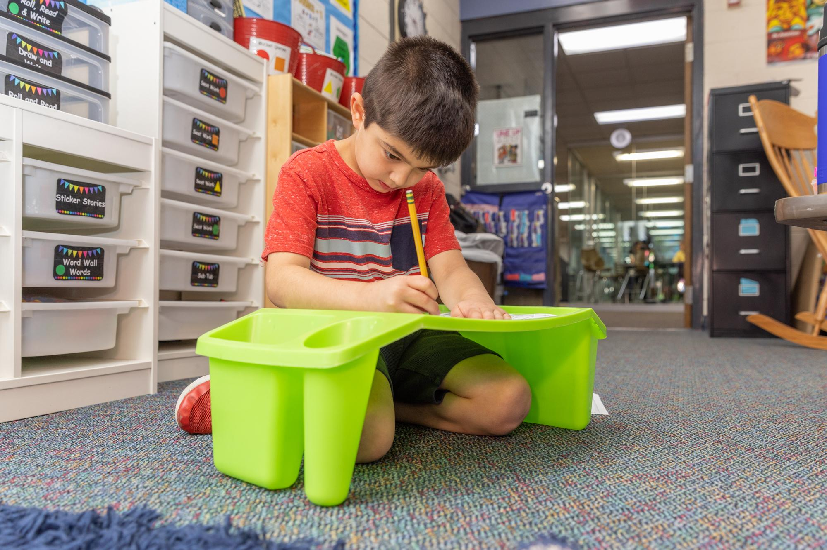
Health Requirements-Dental Exam
Required by May 15, 2026
May be performed any time within the 18-month period prior to the due date (November 15, 2024-May 15, 2026).

Slide 23
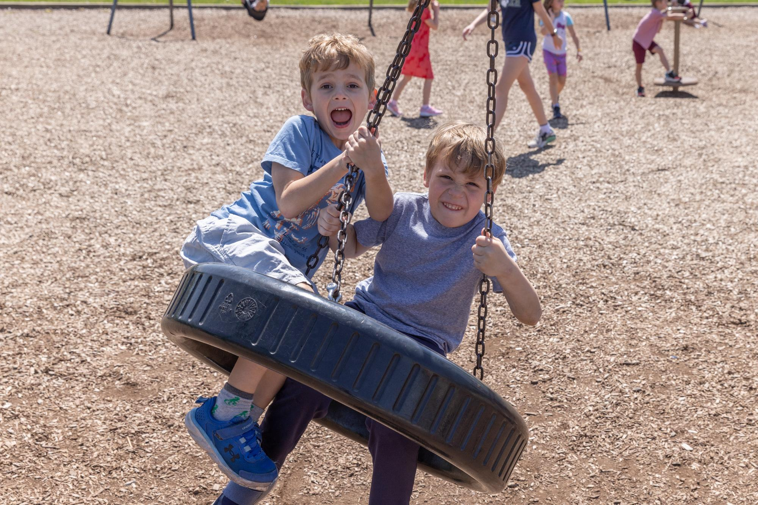
Procedures for Ill Students
Fever: A temperature of 100.4 degrees Fahrenheit is considered a fever (24 hr rule)
Vomiting/diarrhea (24 hr rule)
Undiagnosed Rashes
Conjunctivitis (Pink Eye)
Head Injuries (district protocol)
Medication (all need Doctor’s orders/form, cough drops permission on online registration)
Emergency Contacts (we call in order)

Slide 24
Attendance
ALL absences MUST be called into the health office by 10:00 AM on the attendance line (630-420-6350) or submitted through the Infinite Campus Parent Portal
If you do not do one of the above, Mrs. Wood will be calling you per state laws and district protocols
Every day of kindergarten is important and attendance habits begin early

Slide 25
Students must be HEALTHY to be EDUCATED and EDUCATED to be HEALTHY
Working together is ideal!
Forms on district website
Departments and Services <Health Services<Health Forms
Please feel free to contact your school nurse with any concerns or questions regarding individual student health situations
jaccardo@naperville203.org
630-637-4031

Slide 26
The Association's purpose has been to promote
closer cooperation and understanding between schools and the
home. All Prairie parents, teachers, and staff are automatically considered members of the Association.
Prairie School is a member of District 203's General Home and School Association, which serves as the coordinating organization for all the schools in District 203.
All Prairie parents are welcome to attend our Association meetings and may locate opportunities to get involved in our many activities and events held throughout the year on our Home & School website.
Notes:
Brian
Tia Claffy
Prairie’s H & S is top notch. We truly collaborate to enhance the educational programming for our students.
Get involved- you won’t regret it. Your kids love to have you involved at Prairie and you will make some great friends along the way

Slide 27
The School Family Community Partnership (SFCP) is an organization composed of school staff and parent volunteers who work toward providing activities for students, families and community members that enrich the school experience, support the school improvement plan, and are consistent with the frameworks provided by the National Network of Partnership Schools.
Notes:
SFCP
This is a sub committee of H&S, this group plans amazing community events that engage students, staff and parents in the school.

Slide 28
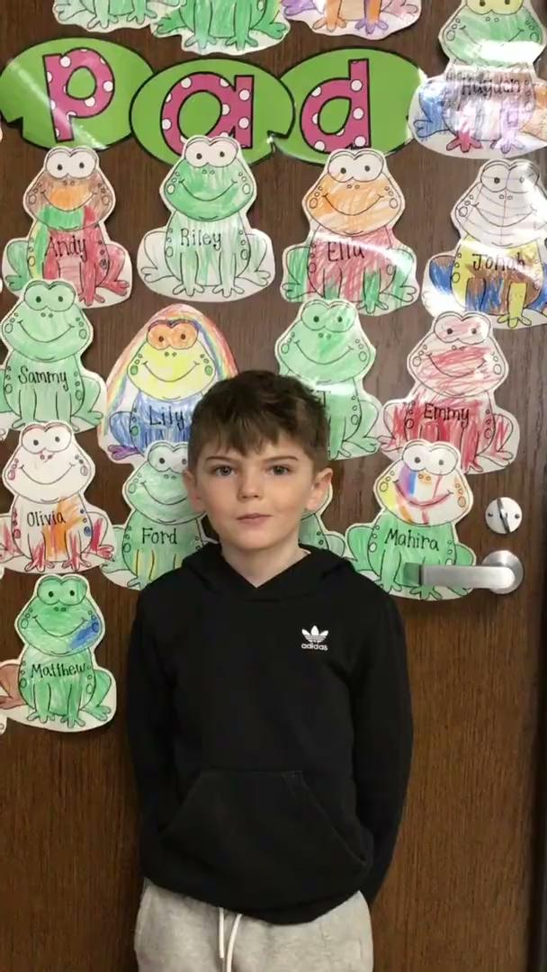
What I love about

Slide 29
Notes:
Trivia Game for Prairie spiritwear

Slide 30
Notes:
Brian
Roots to Grow:
Provide a nurturing and secure environment for children.
Help students build foundational skills, both academically and socially.
Foster a sense of belonging and emotional well-being in the classroom.
Wings to Fly:
Encourage curiosity, exploration, and creativity.
Support independence and self-confidence in learning.
Empower students to take on challenges and embrace new opportunities.
Working Together:
Teachers, families, and the community collaborate to guide children.
Our goal is to give children the tools to succeed, both now and in the future.
By supporting each child’s growth and development, we help them become capable, confident learners.

Slide 31
Questions?

Slide 32
203 West Hillside Road
Naperville, IL 60540
(630) 420-6300
Naperville203.org
@Naperville203
@naperville203
@napervilledistrict203
@Naperville Community Unit School District 203

